Slide 1
ANSI SQL
SQL Operators

Slide 2

Session Objectives
At the end of the session you will be able to
Describe the Arithmetic operators
Describe the Comparison operators
Describe the Logical operators
Describe the Set operators

Slide 3
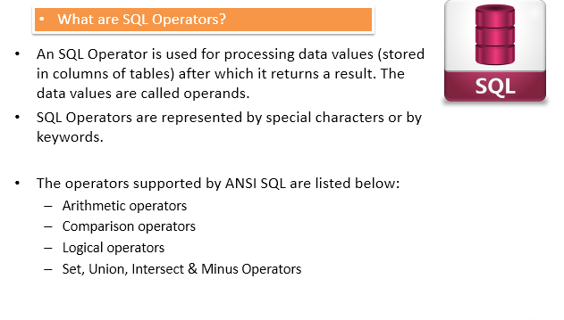
SQL Operators

Slide 4
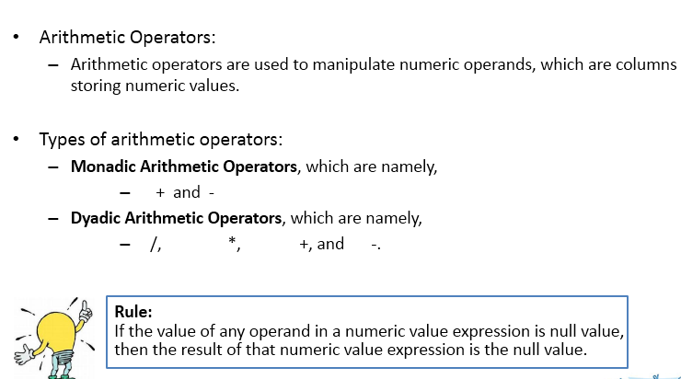
Arithmetic Operators

Slide 5
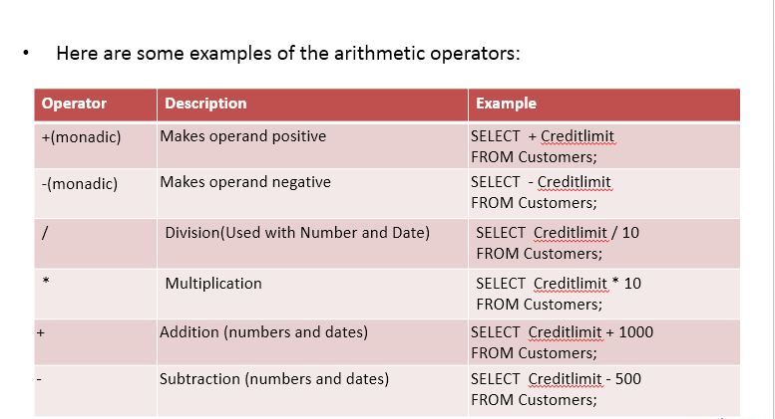
Arithmetic Operators

Slide 6
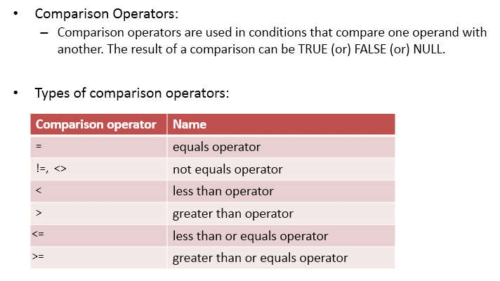
Comparison Operators

Slide 7
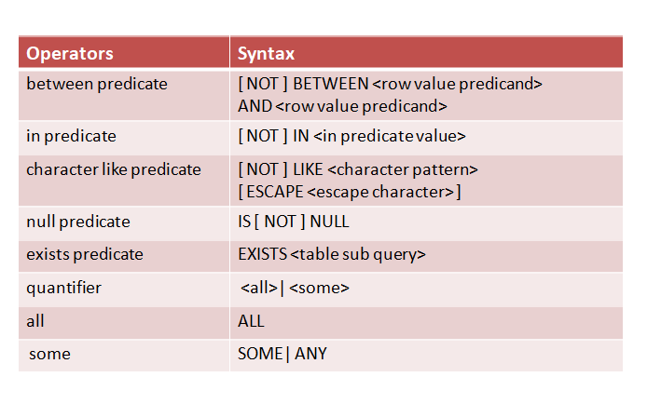

Slide 8
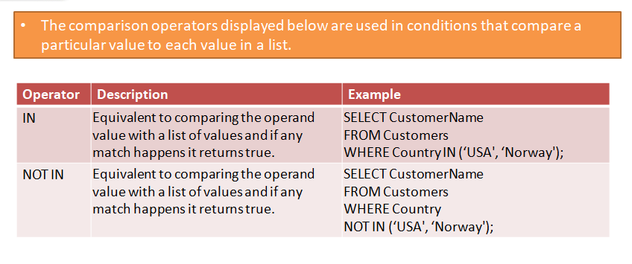

Slide 9
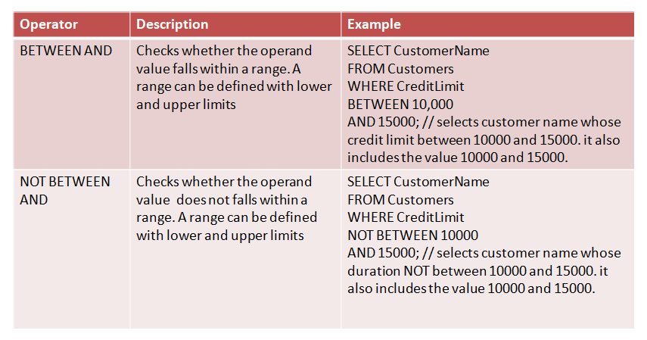

Slide 10
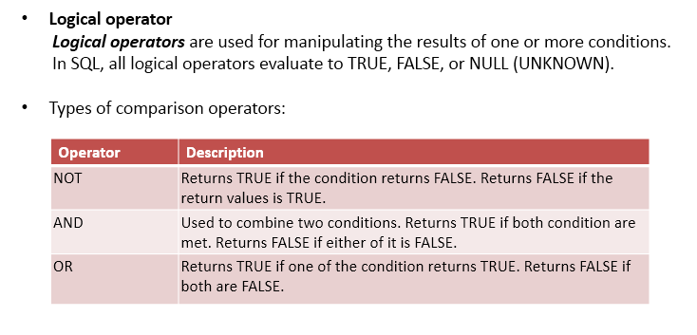
Logical Operators

Slide 11
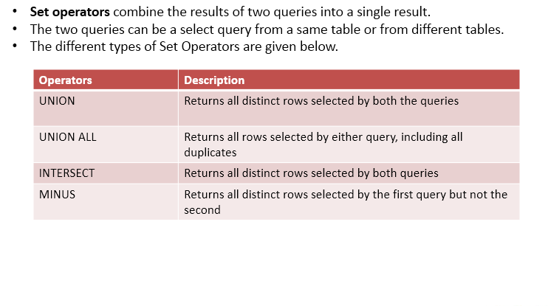
Set Operators

Slide 12
You have completed SQL Operators

